Slide 1







INSTACART
Online grocery store, uncovering customer purchasing behaviors

Slide 2

Objective To distinguish customers and purchasing patterns for Instacart’s marketing campaign approach and effectiveness. Project Brief
Data
Skills and Tools
Python (Pandas, NumPy, Matplotlib, Scipy, Seaborn)
Anaconda Data wrangling
Data merging
Deriving variables
Grouping data
Aggregating data
Reporting in Excel Population flows
GitHub - Python Analysis
An open-sourced 2017 data set provided by Instacart
Constraints:
Data was from single year, 2017
A randomised 70% subset had to be used due to memory issues.
Files link
INSTACART PROJECT

Slide 3
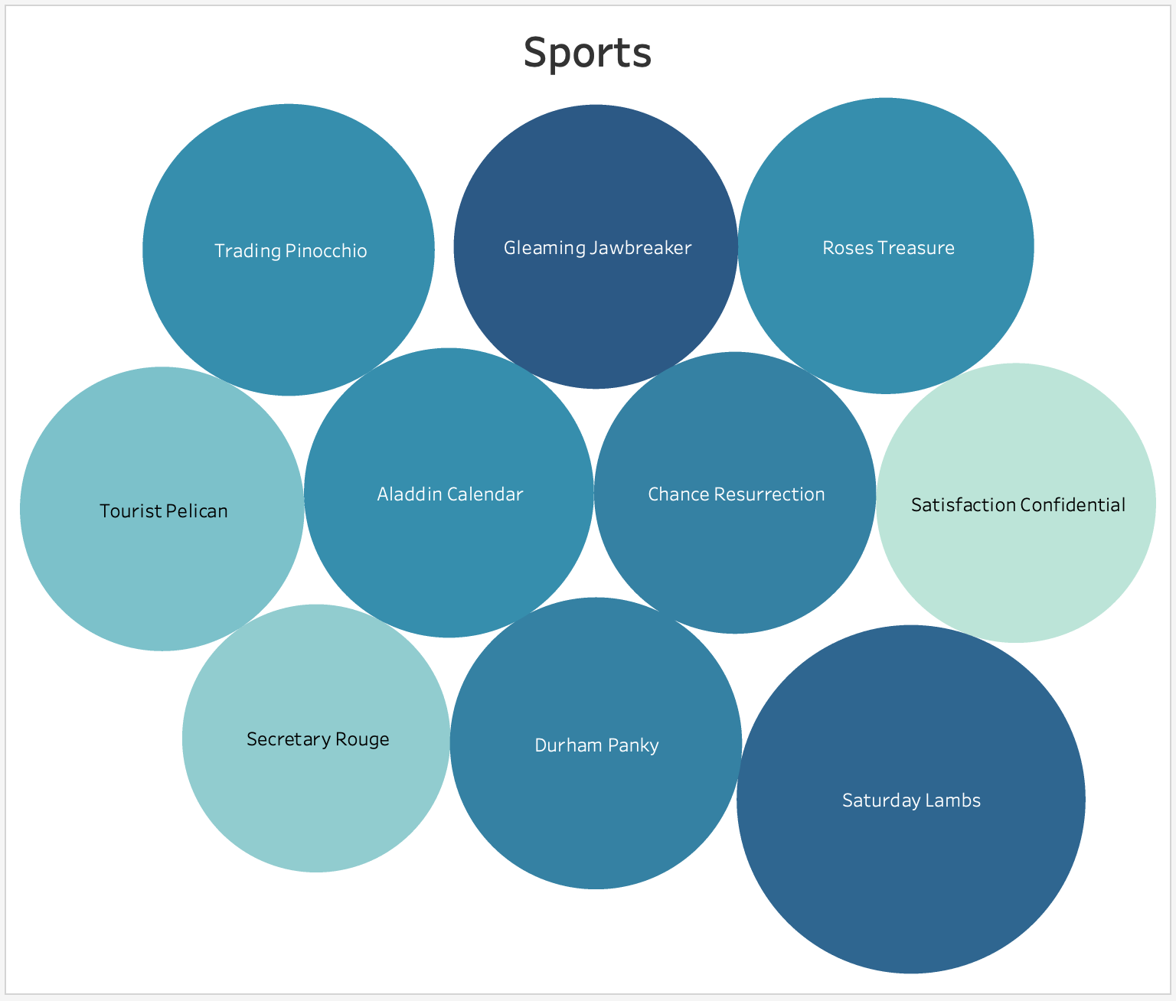
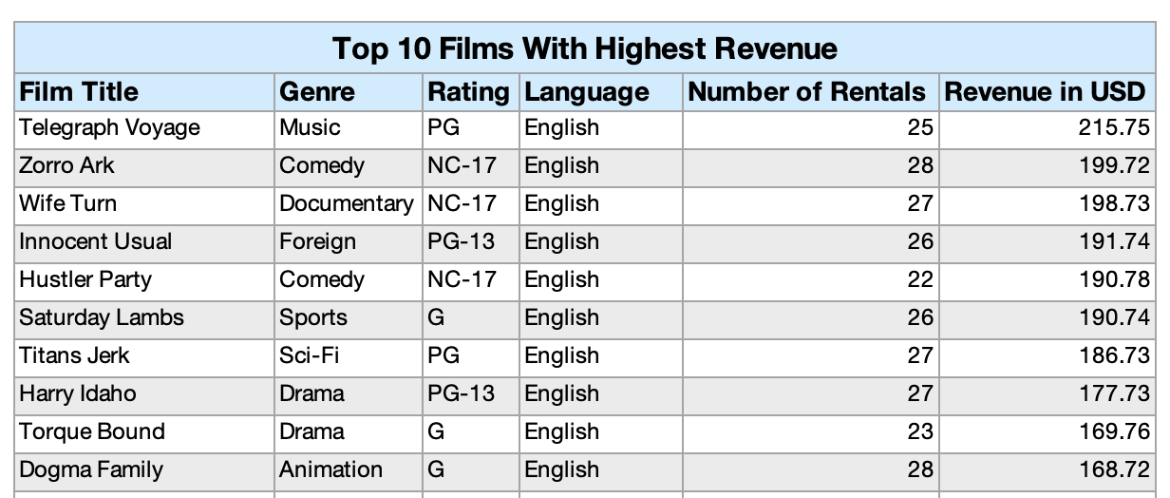
Rockbuster’s Video Rental Market: Countries Distribution: 109 Titles: 1000 Customers: 599 Total Revenue: $61312.04
ANALYSIS
Uppermost Genre in Revenue
Sports
Sci-Fi
Animation
INSTACART PROJECT

Slide 4
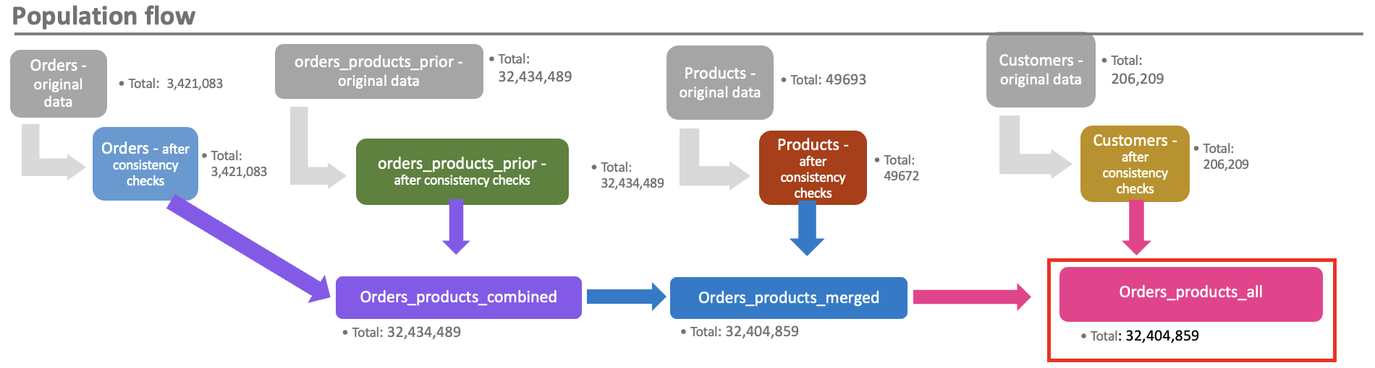
Exclusion flag Condition: max_order < 5 Observations to be removed: PII removed (First name, Last name) Final total count of order_products_all: 30,964,564
ANALYSIS
INSTACART PROJECT

Slide 5
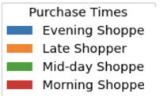
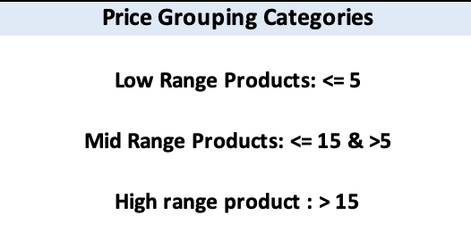
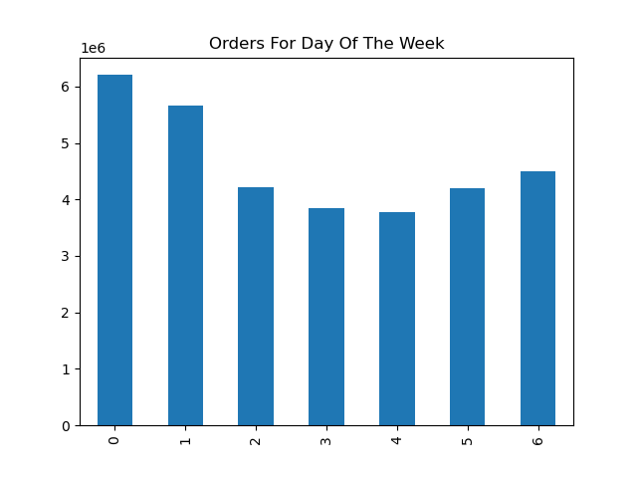
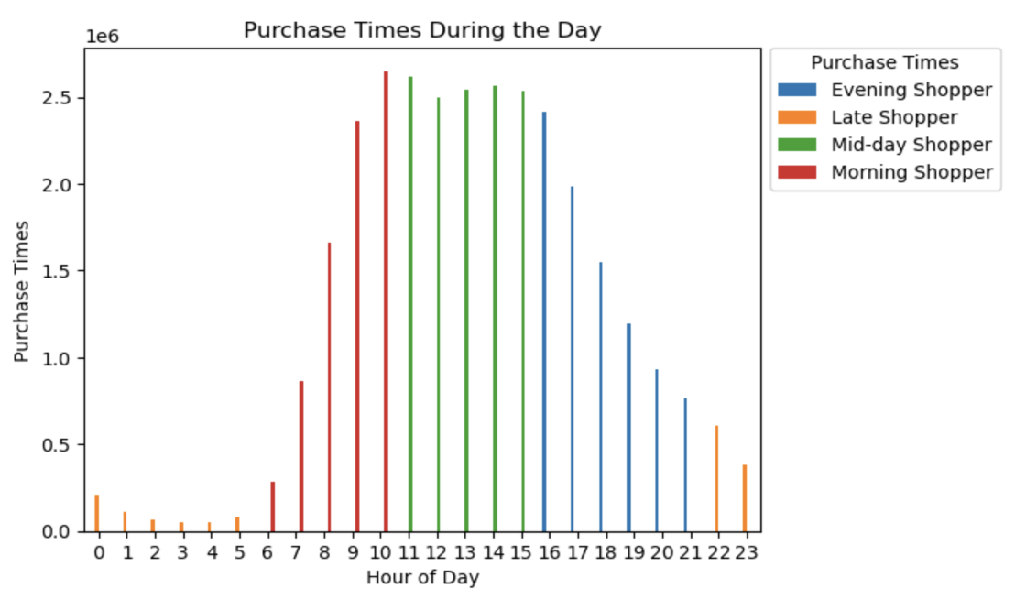
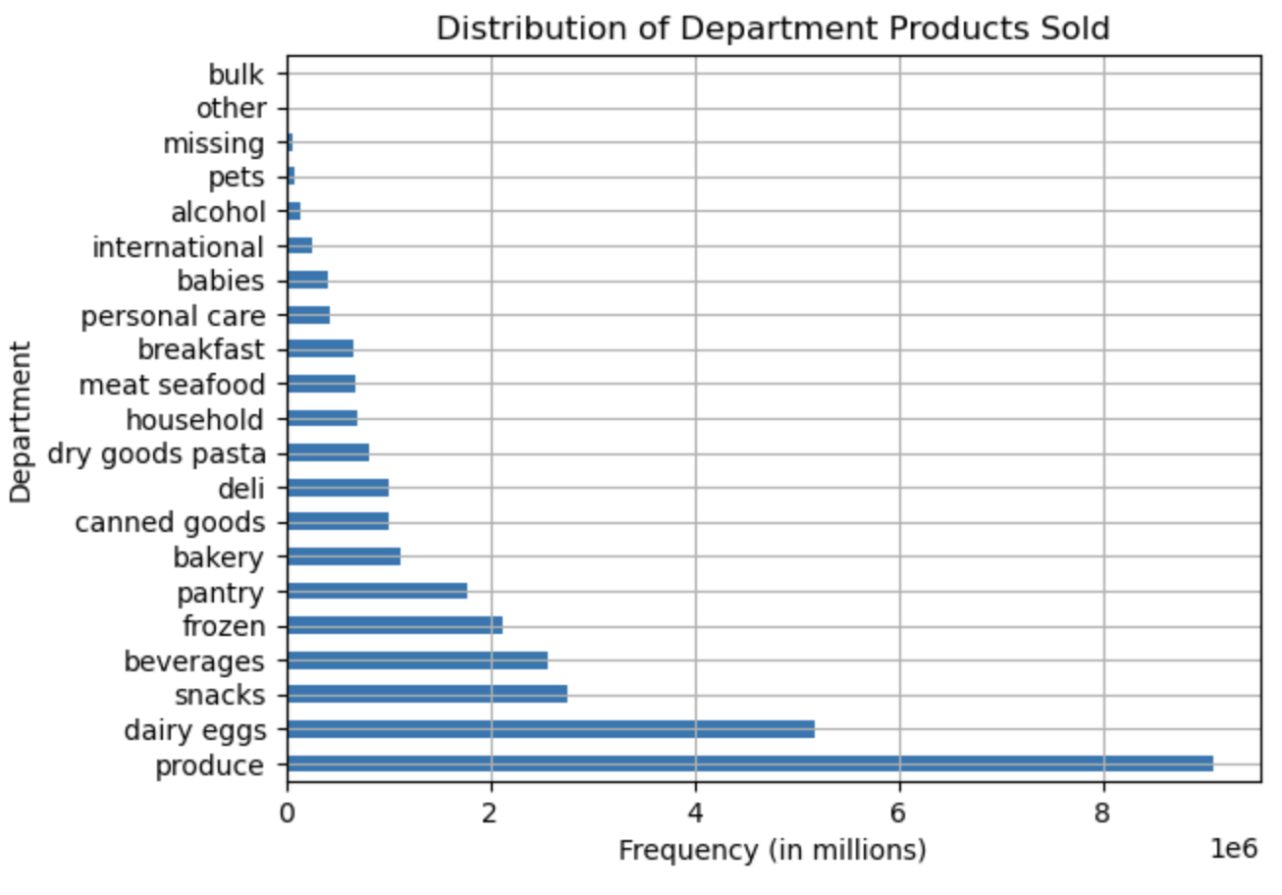
The busiest days of the week for customer orders are Saturday (0) and Sunday (1) while Tuesday (3) and Wednesday (4) remain the least busy.
ANALYSIS
The most active hours of the day for customer orders are
between the hours of 9am and 5pm while between 10pm to 5am are the number of least orders.
The top three items purchased are produce, dairy-eggs, and snacks. Products range in price from $1 - $25 with majority of products under $15, in mid to low range.
INSTACART PROJECT

Slide 6
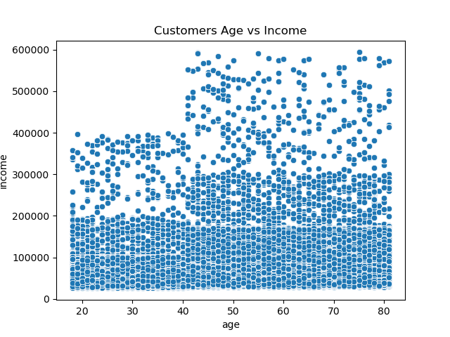
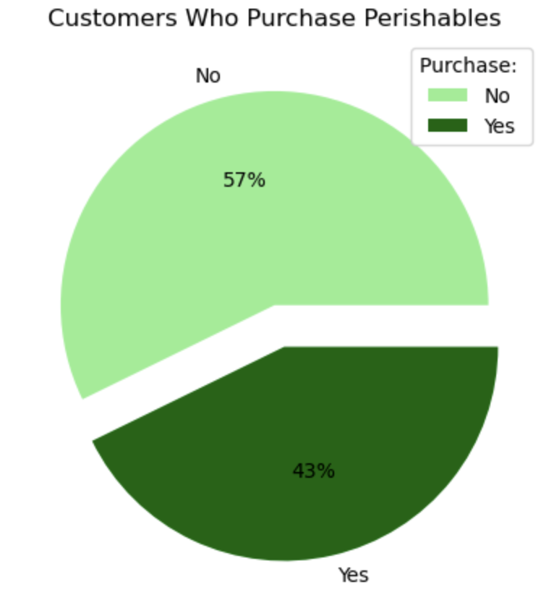
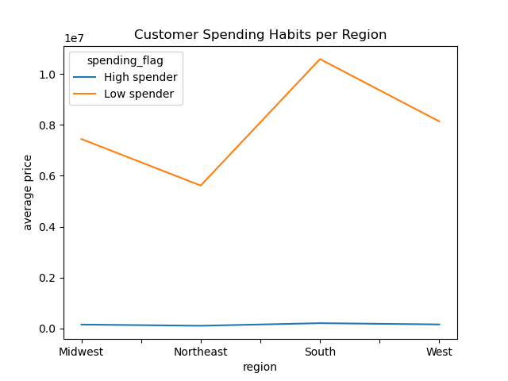
Customers who are middle-aged have greater ordering habits. The income bracket of majority of consumers is middle income as well.
ANALYSIS
No significant variations between the ordering habits of customer profile were observed.
There are differences in ordering habits based on a customer’s region.
The Southern customers place a greater number of orders than the other regions.
INSTACART PROJECT

Slide 7

Recommendations
Based on the analysis of orders, sales and marketing should focus on families with mid-range incomes.
Loyalty perks can be granted to consumers based on level to show appreciation and convert New Customers to Regular Customers.
Inventory should be focused on the mid to low range products (produce, dairy-eggs, and snacks), making sure supplies are stocked for the weekend rush and higher in the Southern region. Limit inventory of bulk and pet supplies as these are not often purchased by customers.
Recommend circulating promotions mid-week to run through the weekend and encourage hot buys mid week of the top purchased items to stimulate orders on slower days.
INSTACART PROJECT

Slide 8




Thank you

